Slide 1



Letrozole in early breast cancer
Supervisors: Assessment committee:
Anne-Vibeke Lænkholm, Associate Professor, MD Inge Marie Svane, Professor, MD, PhD, DMSc
Ann Soegaard Knoop, Consultant, MD, PhD Signe Borgquist, Professor, MD, PhD
Bent Ejlertsen, Professor, MD, PhD, DMSc Mitch Dowsett, Professor, FMedSci, PhD
Submitted August 14, 2020
Defence November 25, 2020

Slide 2

Aim
Evaluate response to neoadjuvant letrozole
Predictive biomarkers for benefit from letrozole
Signe.korsgaard.skriver@regionh.dk
Original Art©2019, Erin McGee Ferrell. ArtistAMERICAN.COM

Slide 3
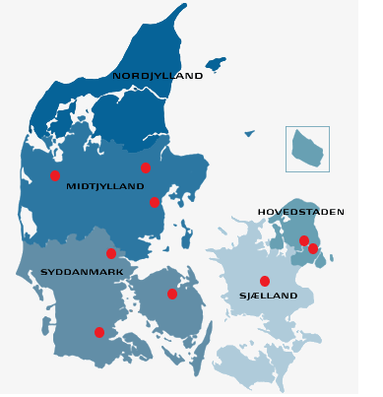
Materials
The “Randomized trial of Endocrine therapy Against Locoregional first” (REAL) study
Neoadjuvant letrozole vs. adjuvant letrozole
Initiated 2009
Endpoint overall survival

Slide 4
Patients
Inclusion
Postmenopausal women ≥ 60 years
Histological confirmed, invasive, operable breast cancer
Estrogen Receptor positive
HER2 normal
≥ 1 cm tumour
ECOG score 0 – 2
Charlson Comorbidity index 0 – 2
Surgery
letrozole
B
R
5 years
letrozole
10 years
follow up
letrozole
4 months
Surgery
Exclusion
Prior cytotoxic treatment
Prior malignant disease

Slide 5
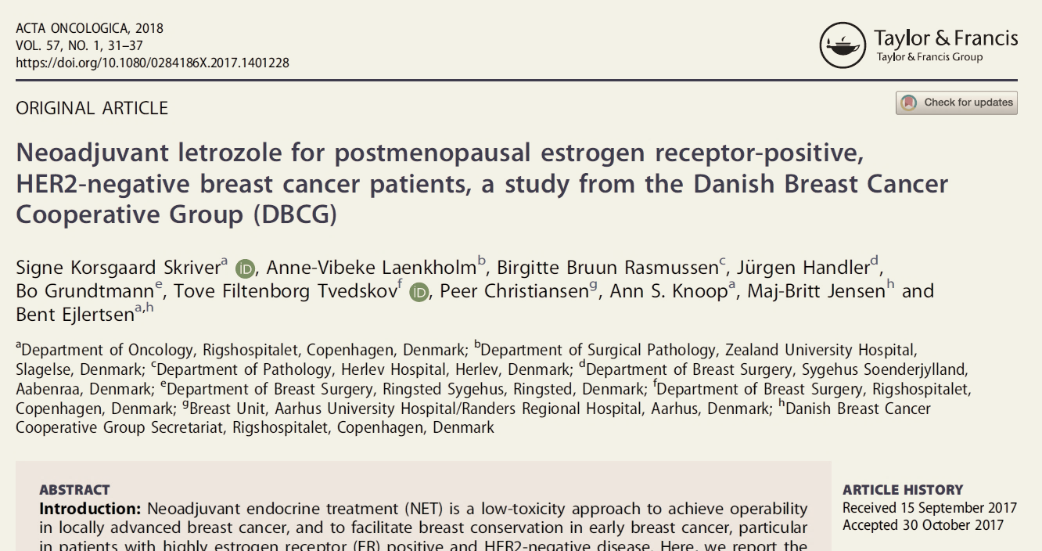
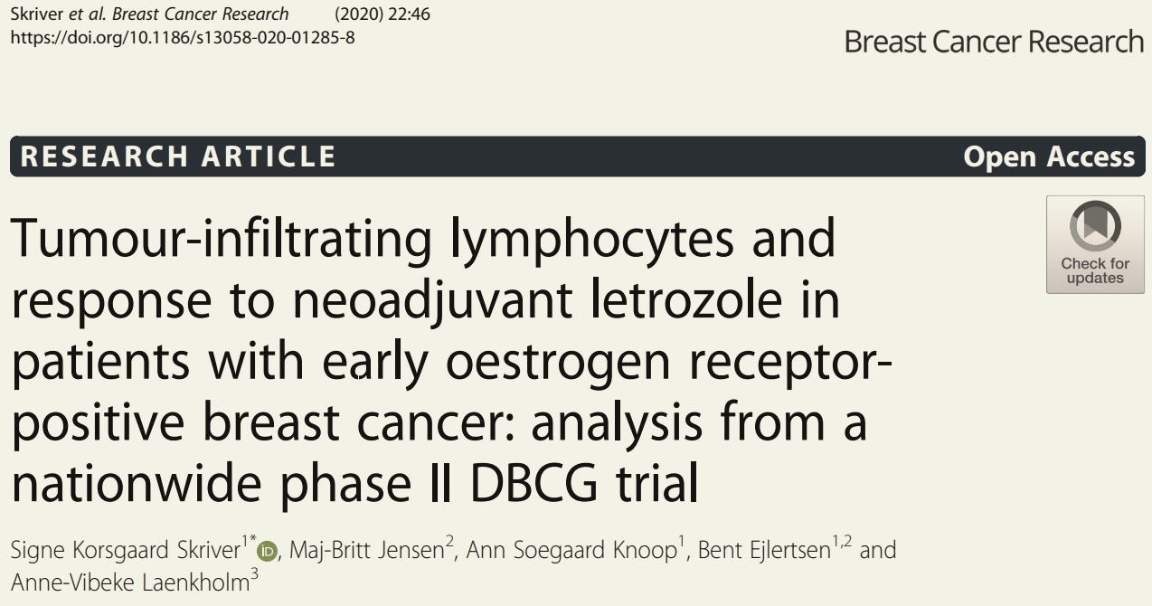
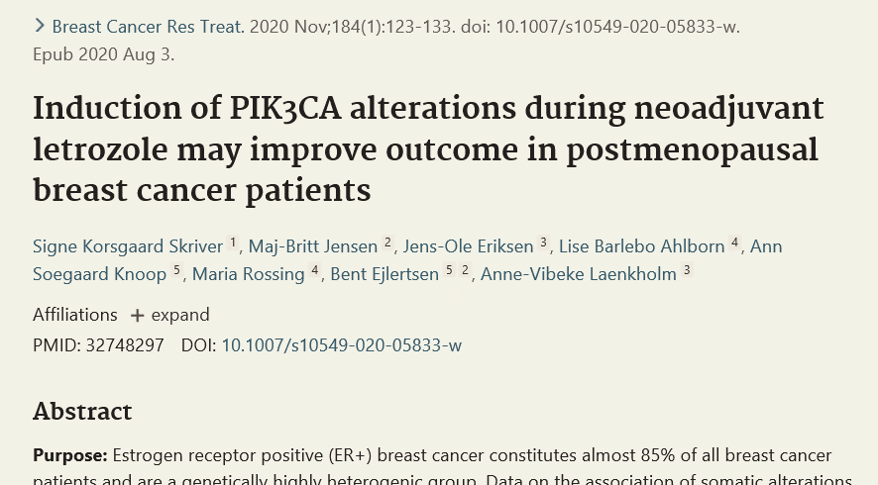
Materials, PhD project
Data and patient samples from the neoadjuvant arm
  Randomized and “selvvælgere”
  Data from DBCG database
  Tissue
Endpoint: response at surgery
B
letrozole
4 months
Surgery

Slide 6
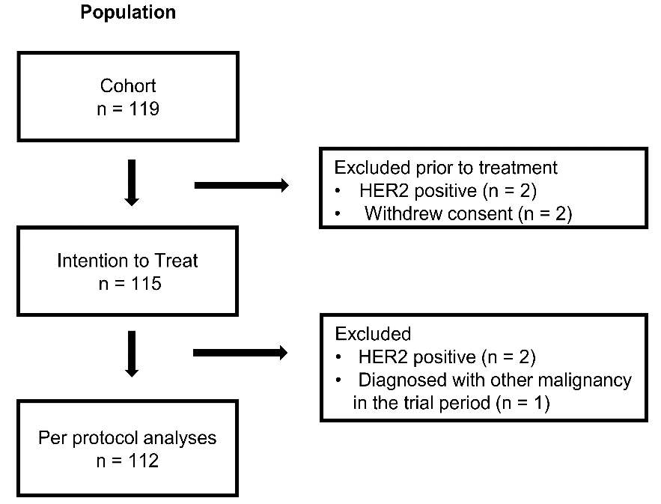
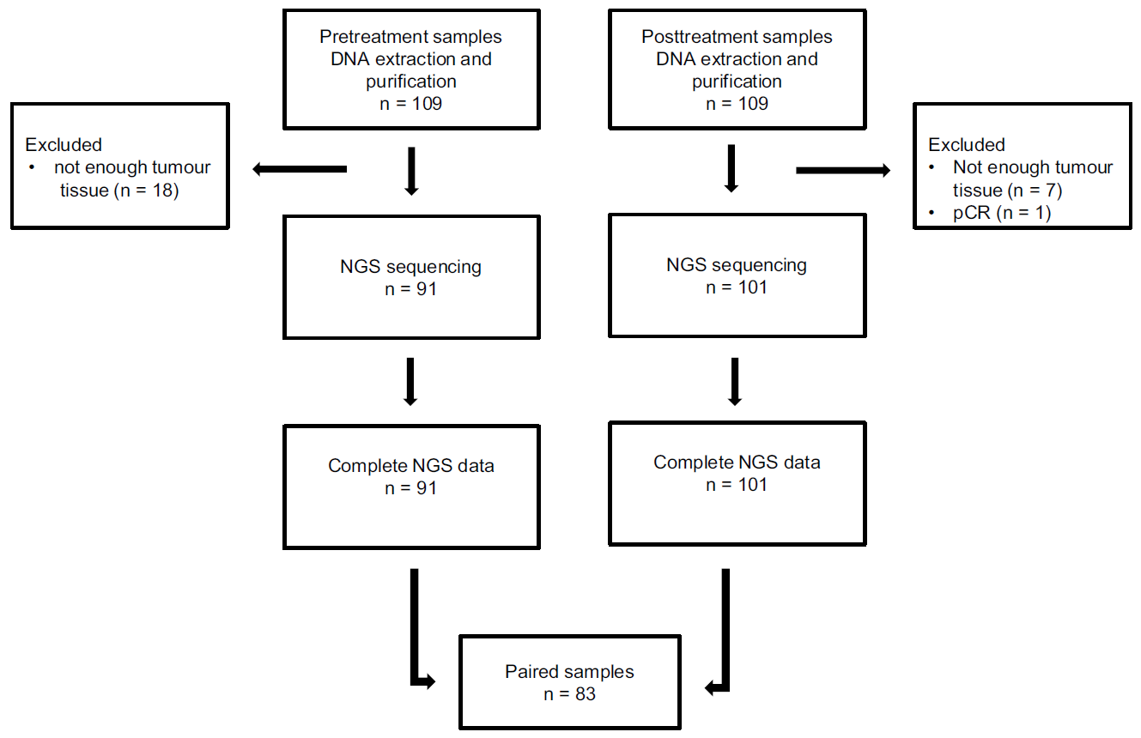
NGS
Biopsy
Surgical specimen
R = 62 (55%)
selvvælgere = 50 (45%)
Parret væv fra 109 patienter til immunhistokemiske analyser samt NGS
NGS rapporter
n = 83
Skriver et al, Acta Oncol, 2018, Skriver et al, Breast Cancer Res Treat, 2020

Slide 7
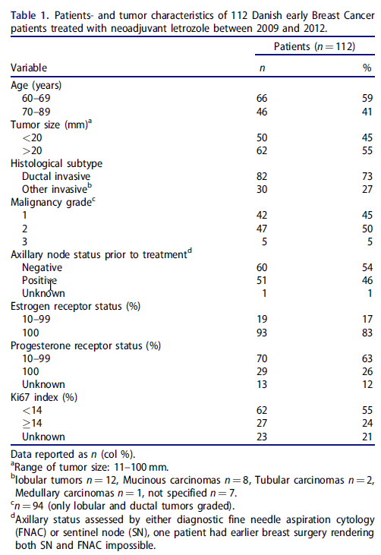
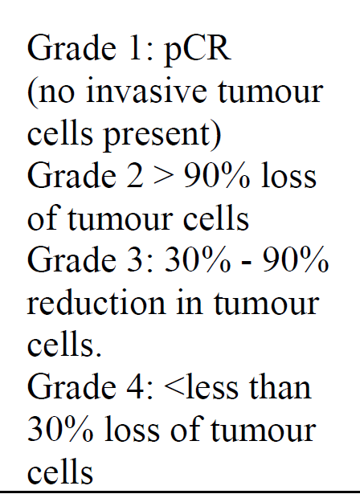
Pathological response
1 pCR
7 minimal residual disease
52 moderate residual disease
48 (44%) no response
Skriver et al, Acta Oncol, 2018

Slide 8
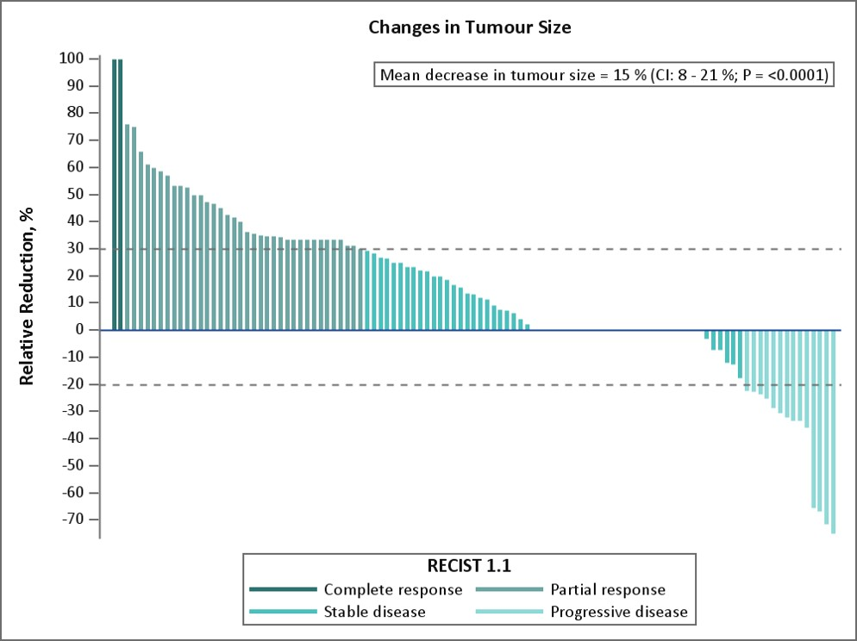
Skriver et al, Acta Oncol, 2018

Slide 9
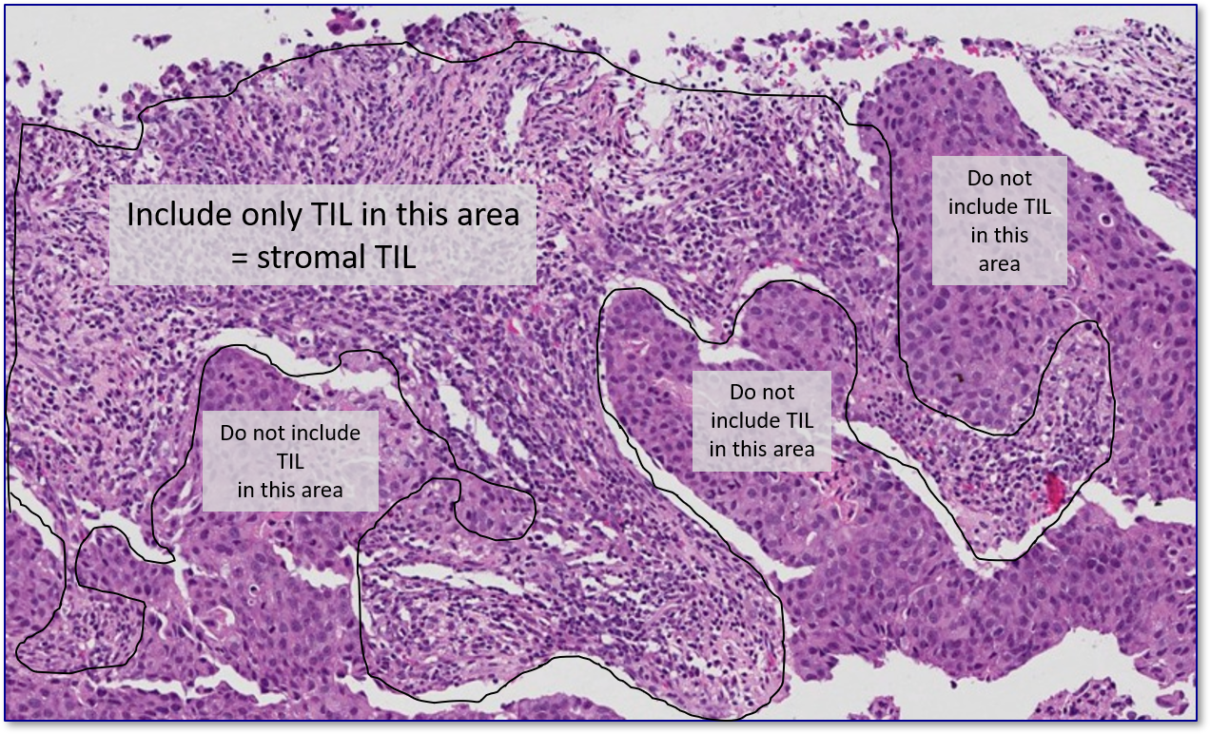
Tumour infiltrating lymphocytes
International Immuno-Oncology Biomarker Working Group on Breast Cancer

Slide 10
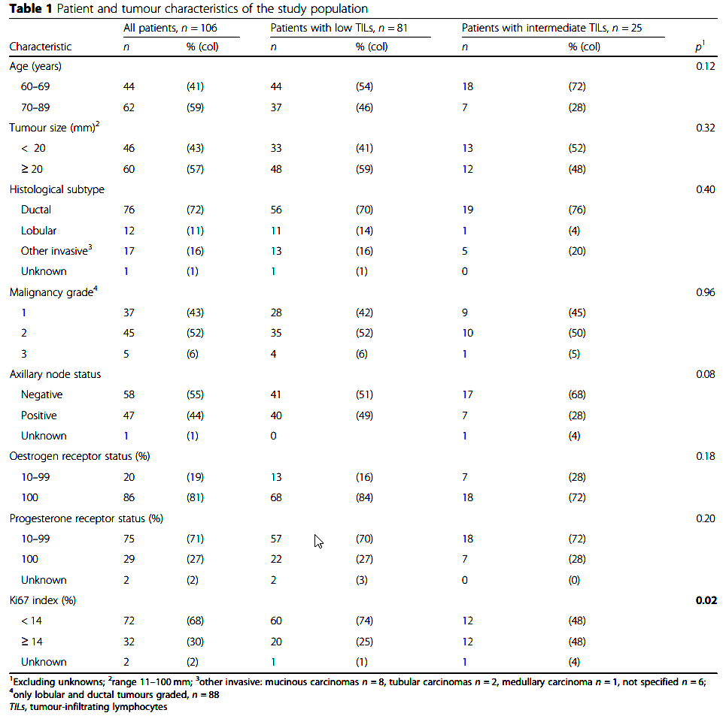
Primary findings:
Baseline TILS 5% mean
Range 0-50%
No difference in distribution of TILs in clinicopathological subgroups except for Ki67
Correlation TILs and Ki67:
Pretreatment: Pearson 0.4; p = 0.0002
Posttreatment: Pearson 0.5; p < 0.0001
Skriver et al. Breast Cancer Research, 2020

Slide 11
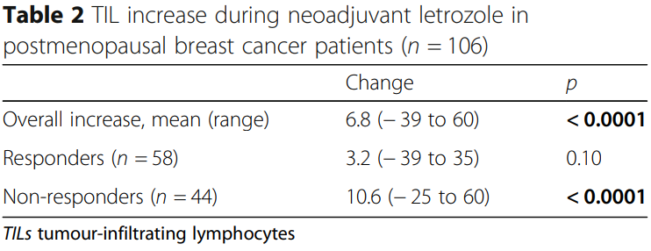
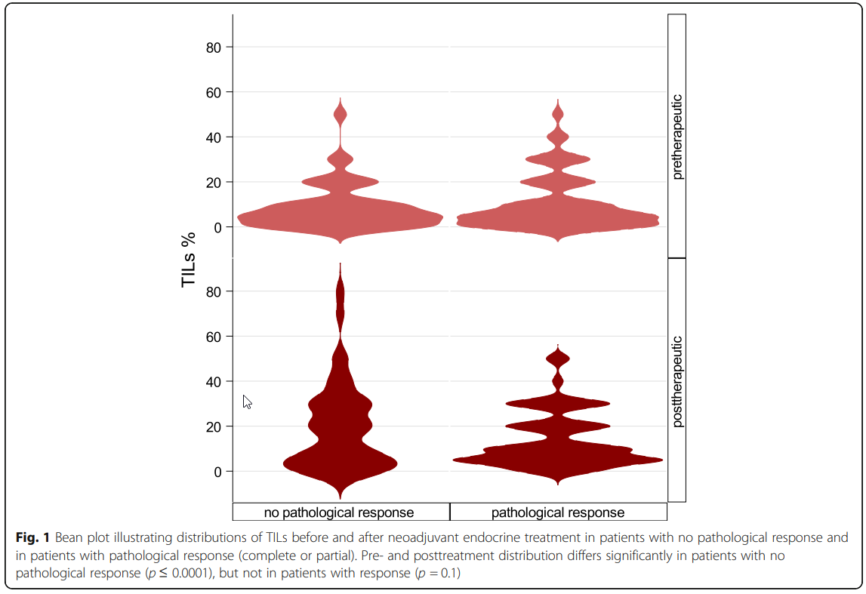
Primary findings:
Increase in TILs associated to response
Multivariate analysis
TILs change
OR 0.71 (95% CI:0.53–0.96)
per 10 % increase in TILs
Subtype
OR 0.37 (95% CI:0.15–0.91)
for non-ductal subtype
No response
Response
Pretreatment
Posttreatment
Skriver et al. Breast Cancer Research, 2020

Slide 12
Mutations in ER+, HER2 normal breast cancer
Increased number of somatic mutations compared to HER2 positive and TNBC
  Heterogenous group in terms of gene expression, genetic alterations and copy number changes
  PIK3CA mutation frequency 25 – 40%
Clinical implications of most driver mutations unknown
PIK3CA mutations associated with favourable prognosis for ER+, HER2 normal breast cancer patients
  Underlying mechanism unknown
  Domain specific?
Koboldt et al. Nature, 2012, Luen et al, JAMA Oncol, 2018,. Griffith et al, Nature, 2018

Slide 13
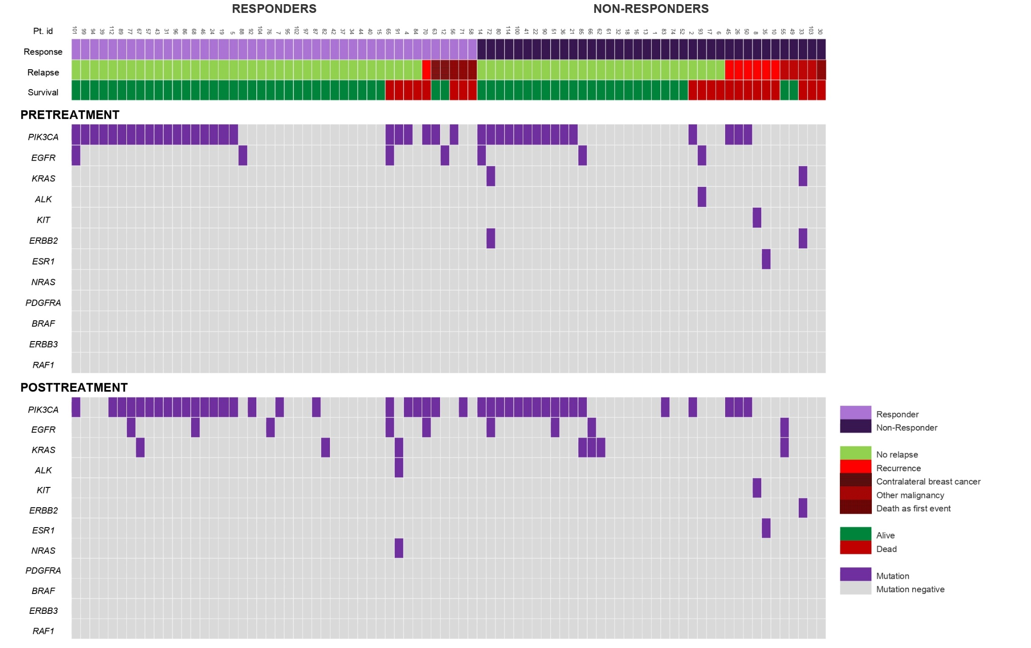
PIK3CA
PIK3CA
Skriver et al, Breast Cancer Res Treat, 2020

Slide 14
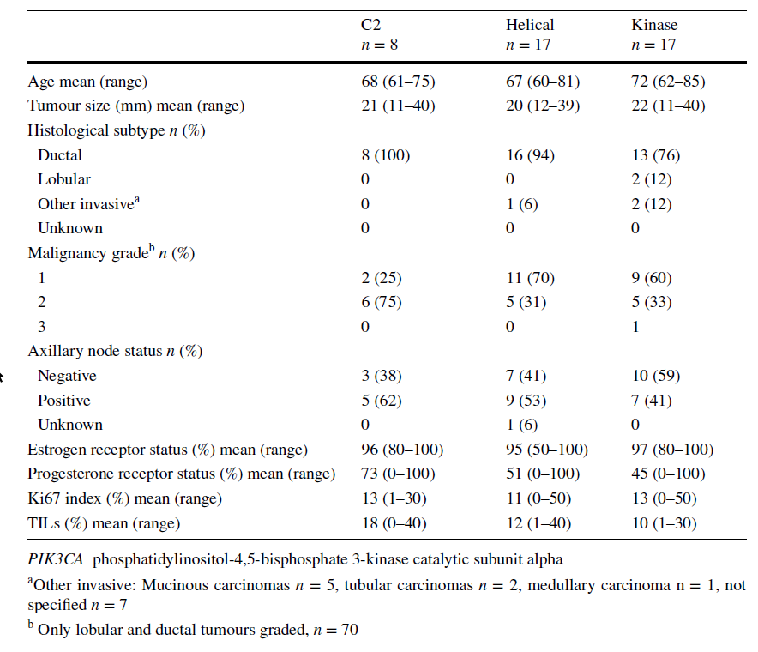
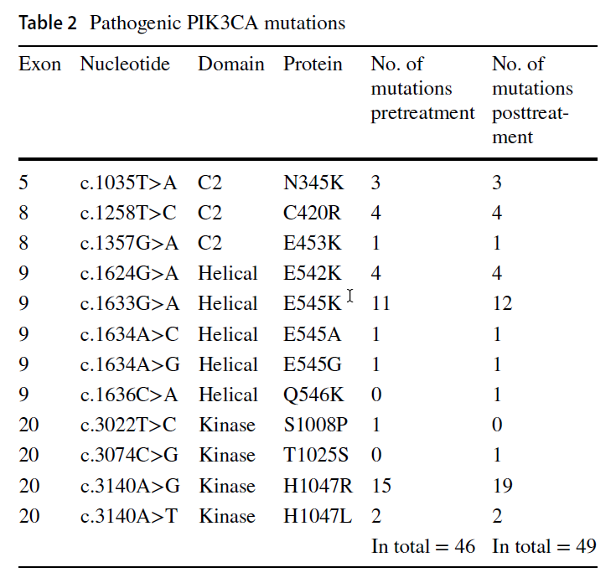
PIK3CA
Primary findings:
More tumours with a ductal subtype harboured PIK3CA mutations
H1047R
and
E545K
Primary findings:
No difference between domains in basic characteristics
Skriver et al, Breast Cancer Res Treat, 2020

Slide 15
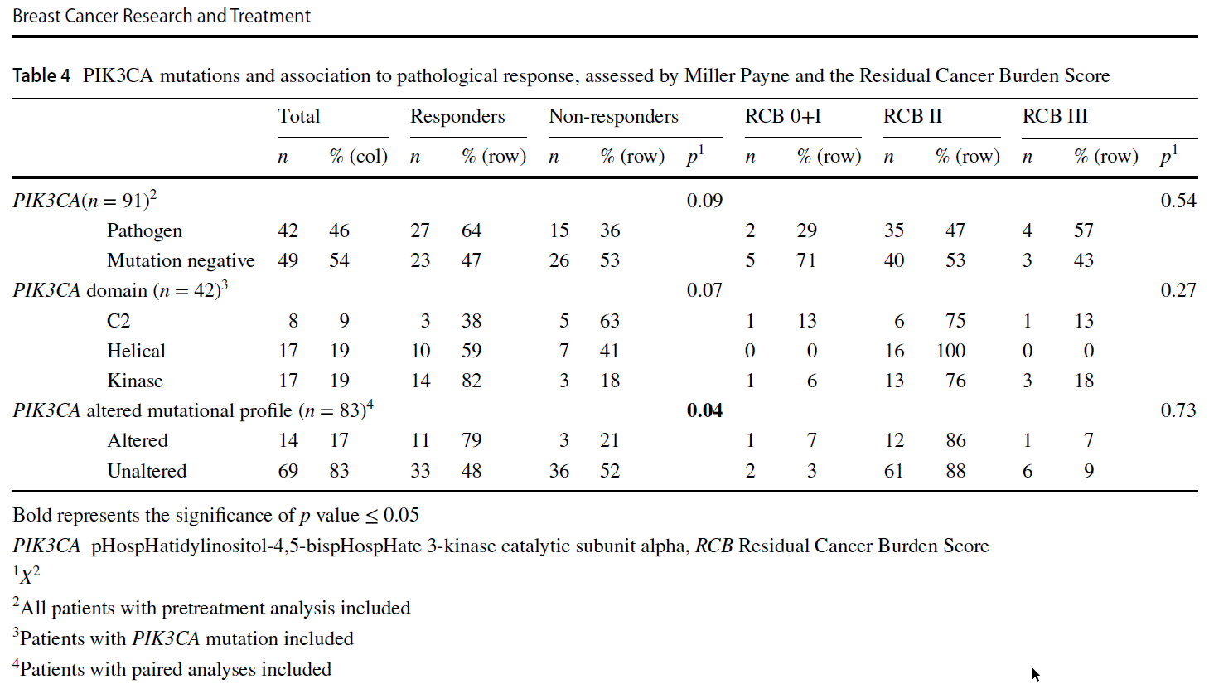
PIK3CA and response
Primary findings:
Instable PIK3CA status associated to improved response
Skriver et al, Breast Cancer Res Treat, 2020

Slide 16
Summery results
  Study I
    Modest pathological and clinical benefit of neoadjuvant endocrine treatment
  Study II
    Increasing TILs → poor outcome
    TILs correlated to Ki67
  Study III
    Heterogenous mutation pattern among patients, and between pretreated and treated tissue
    Instable tumours possibly have improved response

Slide 17
Perspectives
  Upfront endocrine treatment
    Perioperative adaptive strategies
    Phase III litmus test
    Specific clinical settings
      Frail patients
      Pandemics
    Combined with novel agents
      e.g. CDK4/6 inhibitors
  TILs
    Adaptive strategies
    Allocating patients in clinical trials
    Refine residual disease scoring
  PIK3CA
    PCR and gene assays readily available
    PI3K inhibitors increasingly used

Slide 18




Tak for opmærksomheden
Signe.korsgaard.skriver@regionh.dk

