Slide 1
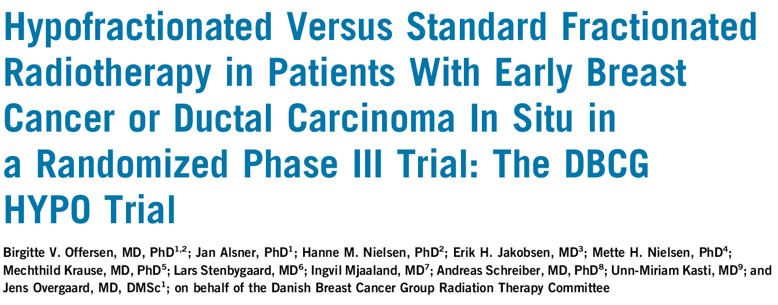


Birgitte V. Offersen
Dept. of Experimental Clinical Oncology,
Aarhus University Hospital,
Denmark
Journal of Clinical Oncology 2020
DBCG Danish Breast Cancer Cooperative Group

Slide 2
No conflict of interest
DBCG Danish Breast Cancer Cooperative Group

Slide 3
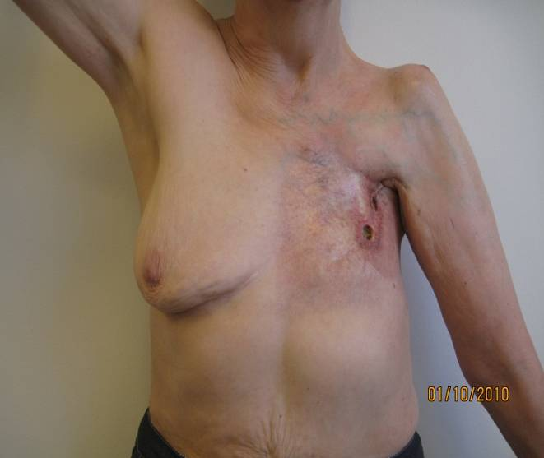
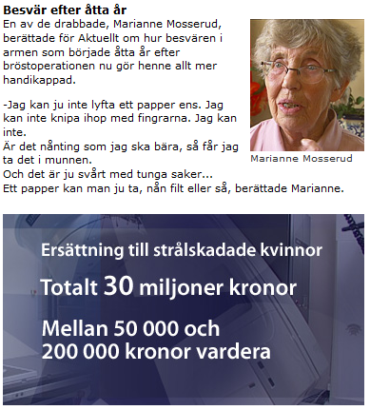

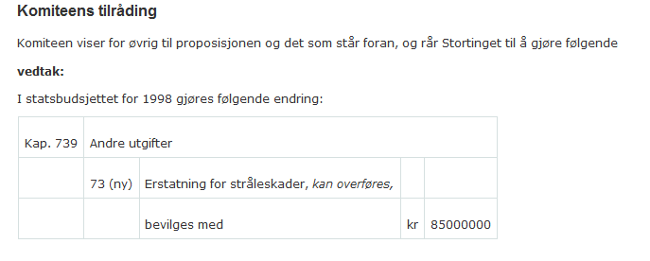


Background DBCG HYPO
Moderate hypofractionation 36-42 Gy / 12 fr DBCG standard before 1982
RT 1980
Photo 2010,
30 yr follow up
~3.3 mio Euro
~9.3 mio Euro

Slide 4

Background DBCG HYPO
Positive results from
Canada (2002)
UK START Trials A & B (2008)
Modern RT techniques
Waiting lists for RT
Poor DBCG results from before 1982
Limited data from patients with
- boost
- large breasts
- modern systemic therapy
DBCG Danish Breast Cancer Cooperative Group
Offersen BV et al, J Clin Oncol 2020

Slide 5
Aim DBCG HYPO
Aim
Reintroduce moderately hypofractionated adjuvant breast radiation therapy (RT) to early node-negative breast cancer patients in a controlled and systematic way in Denmark
Hypothesis
Using 40 Gy / 15 fr (2.67 Gy / fr) for breast RT does not result in more grade 2-3 breast induration at 3 years compared with 50 Gy / 25 fr
DBCG Danish Breast Cancer Cooperative Group
Offersen BV et al, J Clin Oncol 2020

Slide 6
Randomization
Invasive early breast cancer or DCIS, ≥41 yr
Breast conservation
pTis-pT2, pN0-pN1(mic)
Any histology / ER / HER2 / grade
Boost allowed
Any breast size
Any systemic therapy
Breast implants not allowed
Whole breast RT 50 Gy / 25 fr
STRATA
Institution
Breast size ≤600 cc vs >600 cc, Chemotherapy yes/no,
Boost yes/no
Whole breast RT 40 Gy / 15 fr
DBCG Danish Breast Cancer Cooperative Group
Offersen BV et al, J Clin Oncol 2020

Slide 7
Endpoints
Primary
  Grade ≥2 breast induration post RT (at 2 or more follow-up visits)
Secondary
  Other RT-related morbidities
  Body image scale and breast photos (pending)
  Patient satisfaction with therapy
  Pattern of recurrences
Baseline
1
2
3
4
5
10 Years
DBCG Danish Breast Cancer Cooperative Group
Offersen BV et al, J Clin Oncol 2020

Slide 8

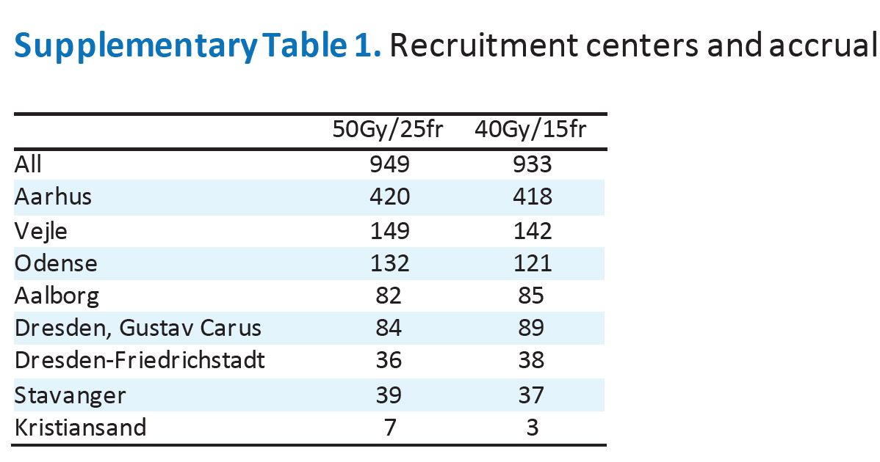
Baseline data
Accrual May 2009 - Mar 2014
DBCG Danish Breast Cancer Cooperative Group
Offersen BV et al, J Clin Oncol 2020

Slide 9
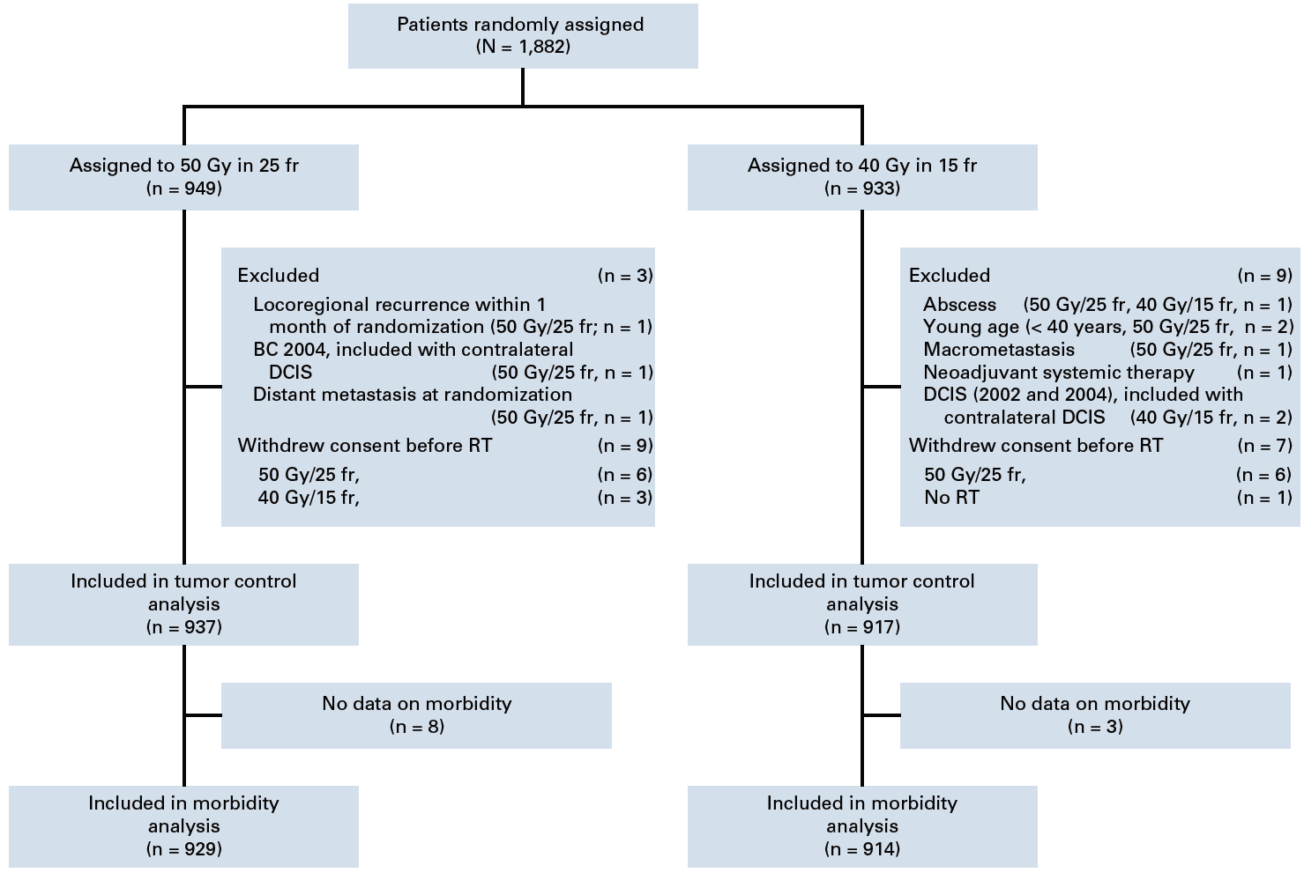
Consort diagram
98.5%
98.1%
5-year morbidity evaluation in 1452 patients (77%)
DBCG Danish Breast Cancer Cooperative Group
Offersen BV et al, J Clin Oncol 2020

Slide 10
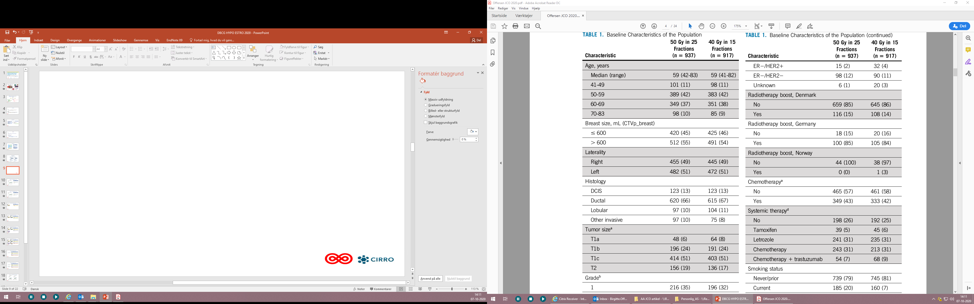
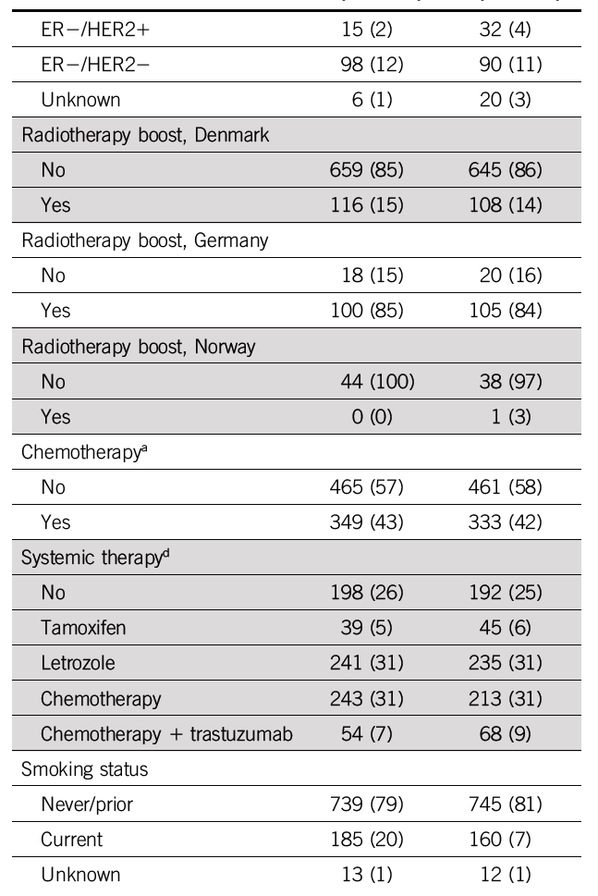
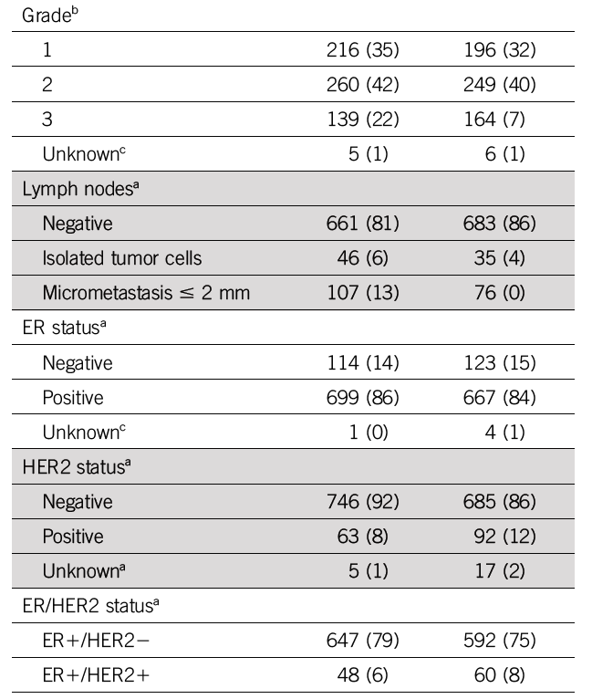
Baseline characteristics
160 (17)
Offersen BV et al, J Clin Oncol 2020

Slide 11
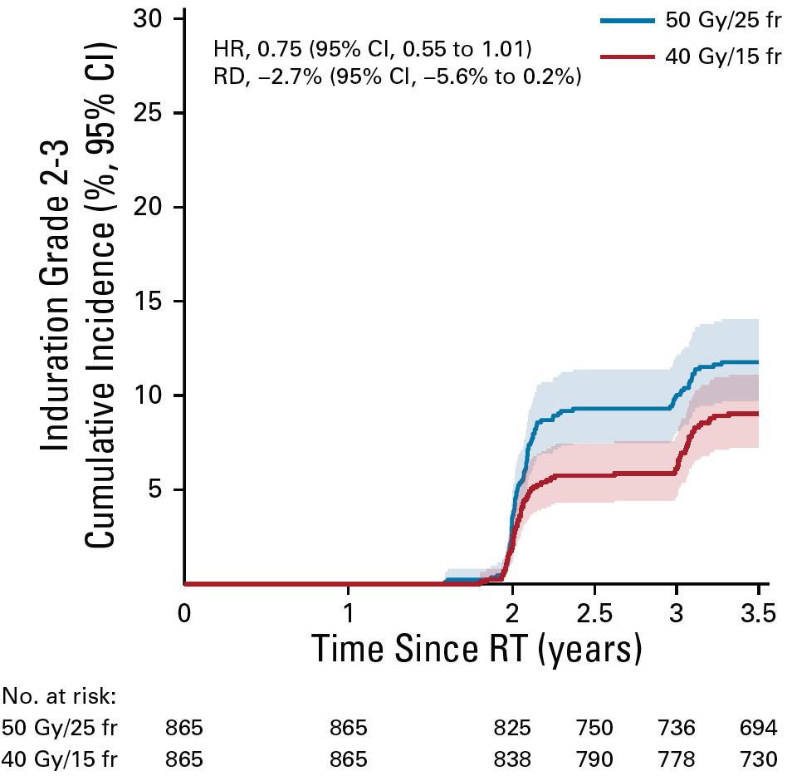
Induration – Main analysis (N=1830)
Median follow up 7.29 years
In univariate analysis, 40 Gy / 15 fr is not associated with an increased risk of induration
DBCG Danish Breast Cancer Cooperative Group
Offersen BV et al, J Clin Oncol 2020

Slide 12
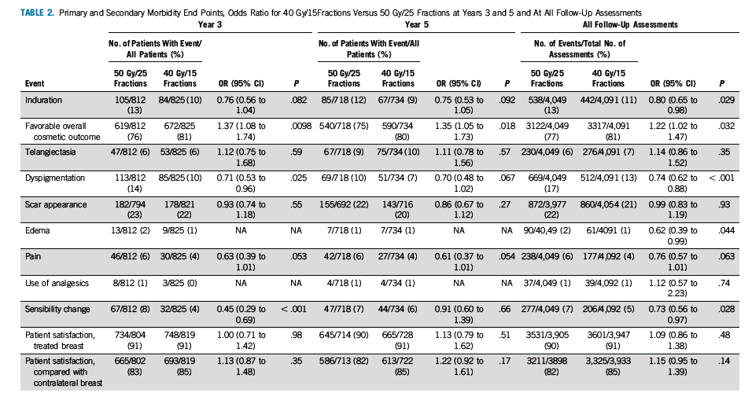
RT related morbidities
Fasthed i bryst
Pænt kosmetisk udseende af bryst
Karsprængning i hud på bryst
Misfarvning af bryst
Udseende af ar på bryst
Ødem i bryst
Smerte i bryst
Bruger smertestillende pga bryst
Ændret følesans på bryst
Pt tilfreds m bryst
Pt tilfreds m bryst sml med modsat side
No difference or better outcome with 40Gy depending on endpoint and time
DBCG Danish Breast Cancer Cooperative Group
Offersen BV et al, J Clin Oncol 2020

Slide 13
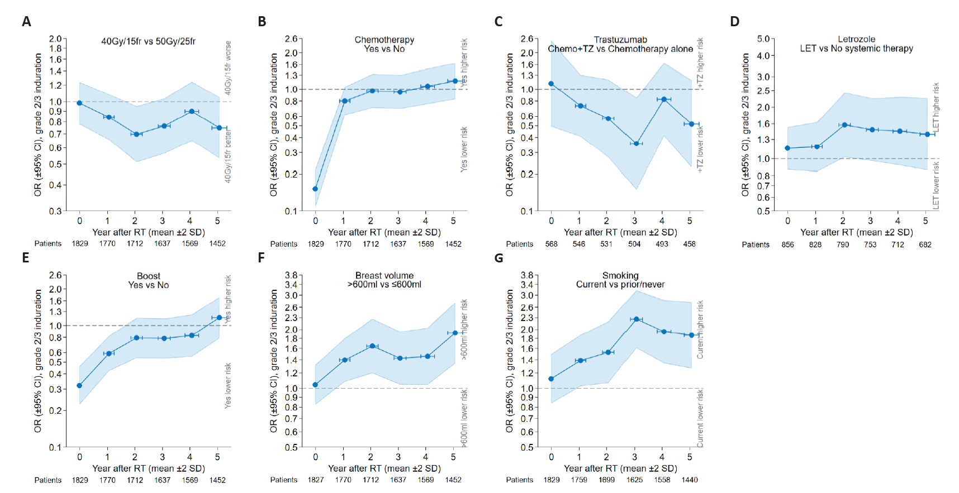
Induration – preplanned subgroups
DBCG Danish Breast Cancer Cooperative Group
Offersen BV et al, J Clin Oncol 2020

Slide 14
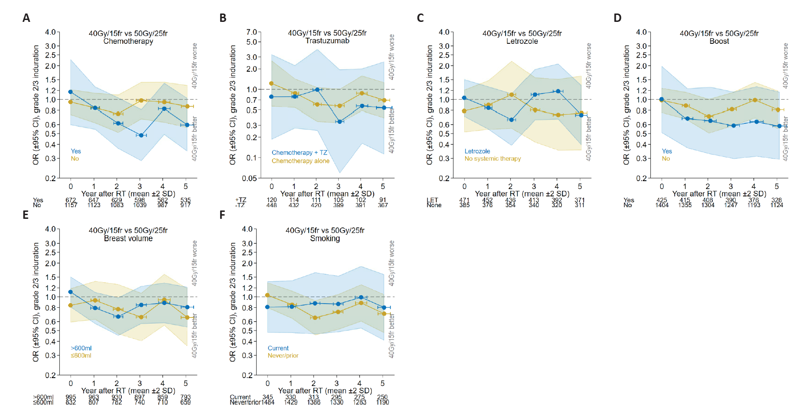
Induration – preplanned subgroups by fractionation
40Gy/15fr does not worsen the RT-related morbidity from other causes
DBCG Danish Breast Cancer Cooperative Group
Offersen BV et al, J Clin Oncol 2020

Slide 15
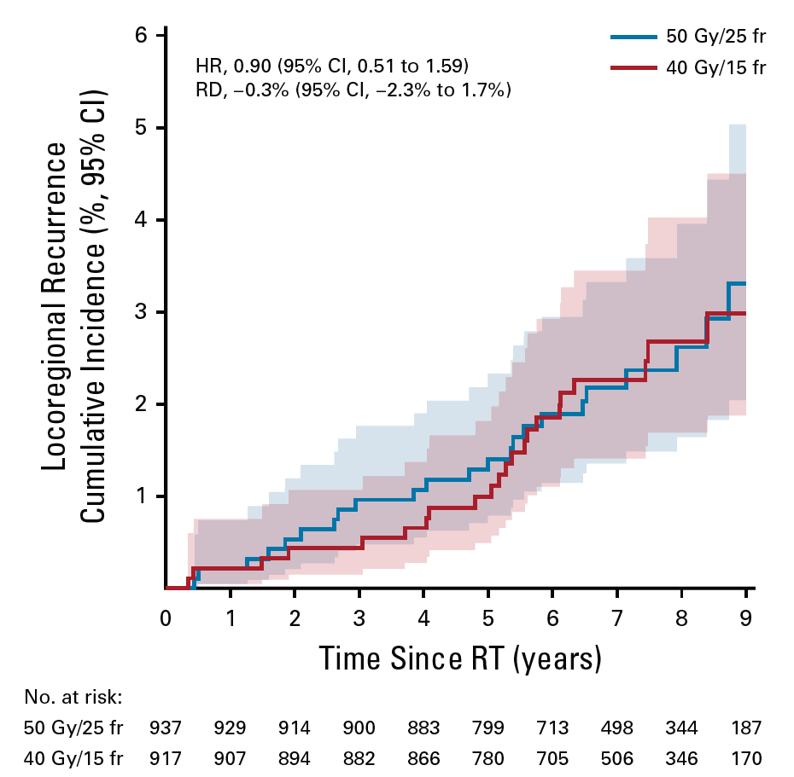
Loco-reg recurrence
Whole cohort
N=1854 pts
LRR / number of patients
50Gy: 19 / 814
40Gy: 14 / 794
DBCG Danish Breast Cancer Cooperative Group
Offersen BV et al, J Clin Oncol 2020

Slide 16
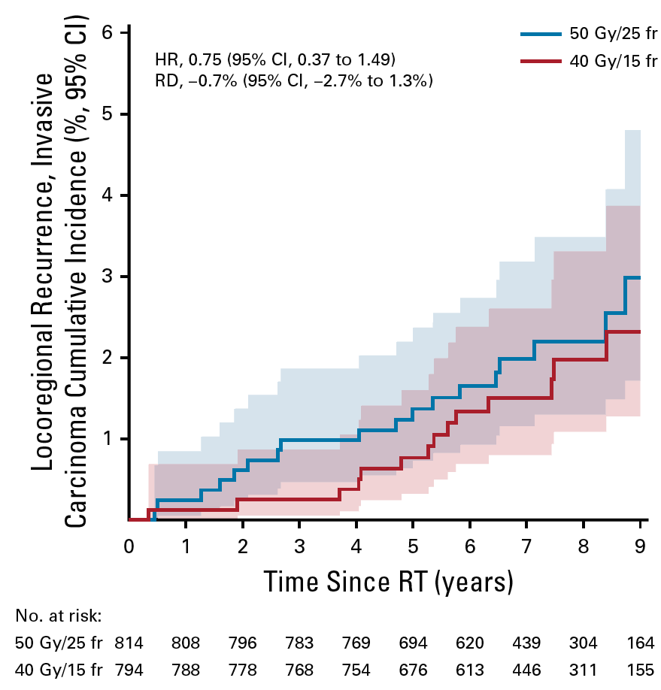
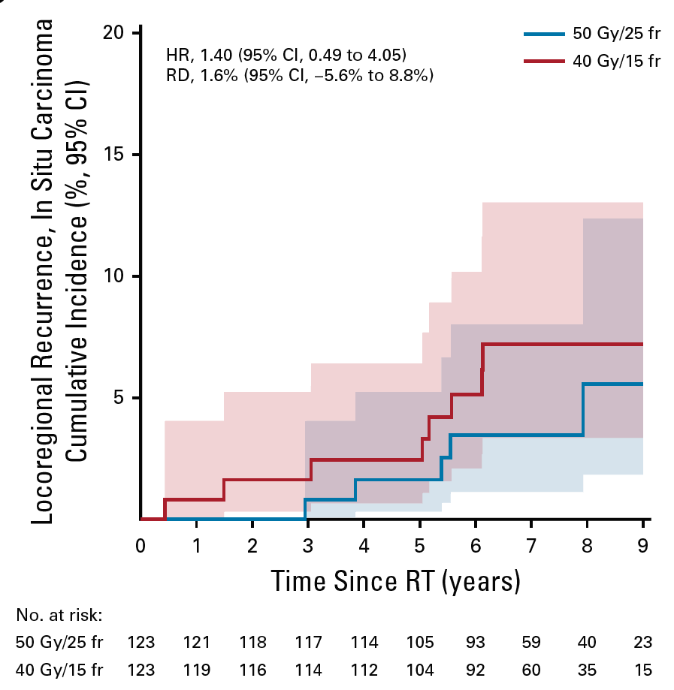
Loco-reg recurrence
Inv carcinoma
N=1608 pts
DCIS cohort
N=246 pts
Whole cohort
N=1854 pts
LRR / number of patients
50Gy: 19 / 814
40Gy: 14 / 794
DBCG Danish Breast Cancer Cooperative Group
Offersen BV et al, J Clin Oncol 2020

Slide 17
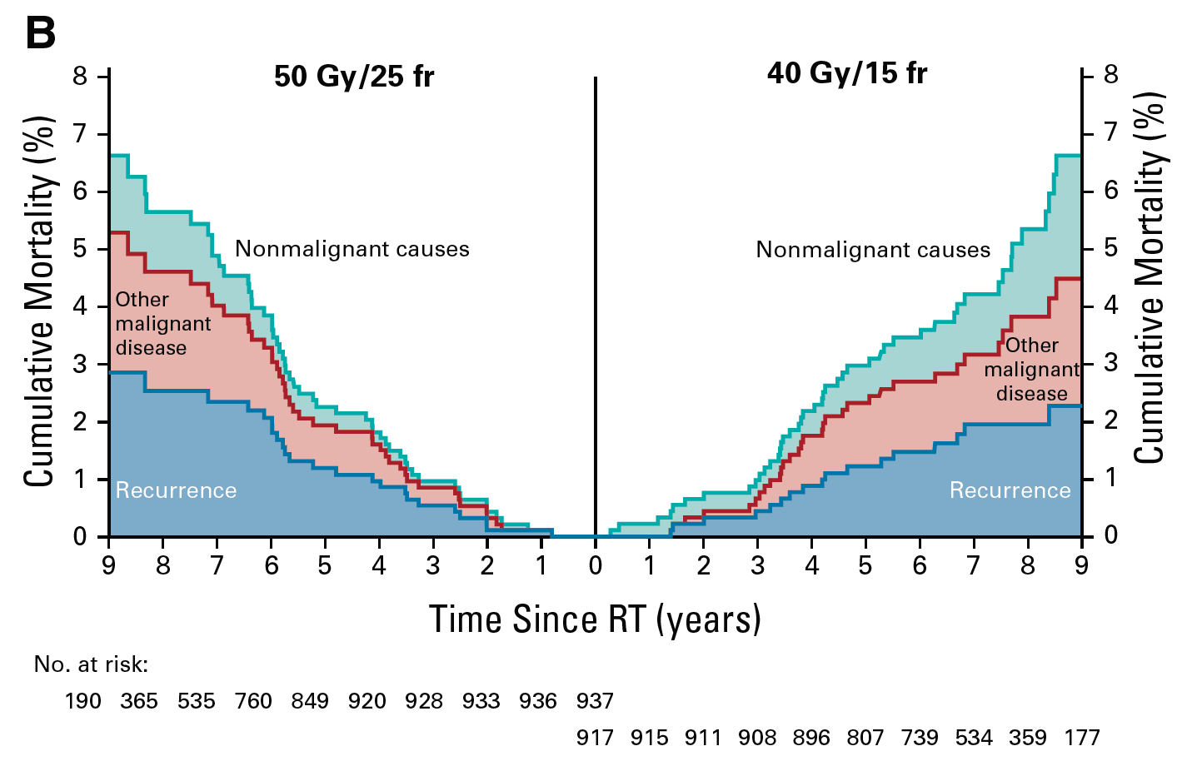
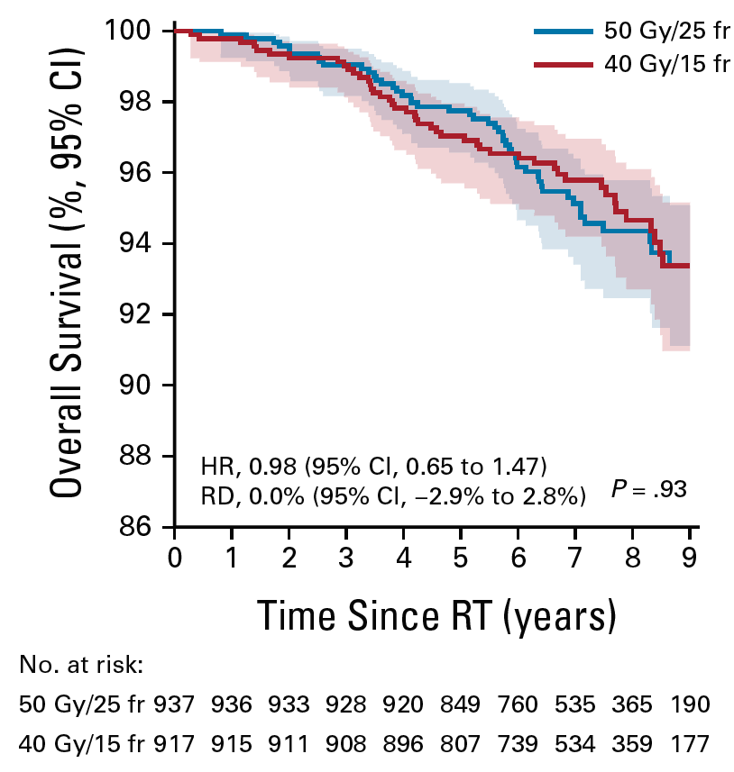
Overall survival
DBCG Danish Breast Cancer Cooperative Group
Offersen BV et al, J Clin Oncol 2020

Slide 18
Conclusion
40 Gy / 15 fr is not associated with an increased risk of induration, neither overall, nor in any of the tested risk groups (boost, large breasts, systemic therapy and/or smokers)
Risk factors for breast induation are: large breast size, current smoker
40 Gy/15 fr is being investigated in the DBCG RT Skagen Trial 1 and the French HYPO G01 trial for high risk breast cancer patients with an indication for loco-regional radiation therapy
DBCG Danish Breast Cancer Cooperative Group
Offersen BV et al, J Clin Oncol 2020

Slide 19
Thanks
Thanks to all participating centres
Thanks to all participating patients
Thanks to The Danish Cancer Society and CIRRO for funding
Thanks to DBCG for support
DBCG Danish Breast Cancer Cooperative Group
Offersen BV et al, J Clin Oncol 2020

